Slide 1
Report an error – new design for REFM issues
Redesign “Workplace services” in Report an error

Slide 2

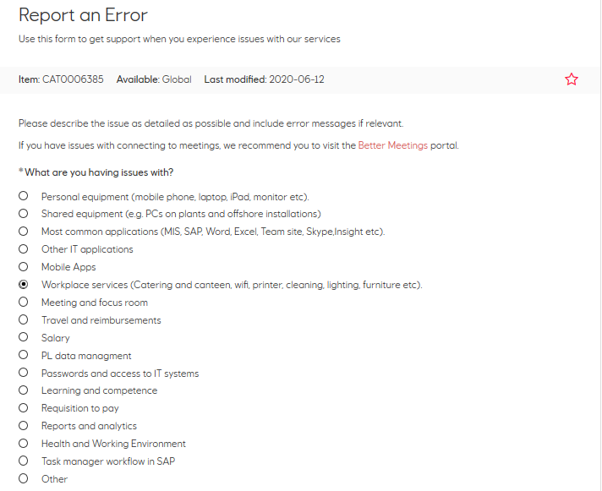
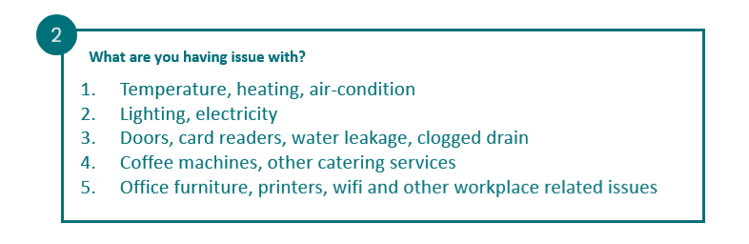
End-user (employe)
1
TO-BE in Services@Equinor
Building and workplace services
SERVICE NOW
Assigned to CI: FM heating, ventilation & sanitary → AG: FM NO OPERATION CENTRE COOR
Assigned to CI: FM electro installations → AG: FM NO OPERATION CENTRE COOR
Assigned to CI: FM building O&M → AG: FM NO OPERATION CENTRE COOR
Assigned to CI: FM catering services → AG: FM NO OPERATION CENTRE COOR
Assigned to CI: FM workplace service → AG: FM NO OPERATION CENTRE COOR

